Slide 1
Voxelab Aquila ++
By: th3t3am

Slide 2
Problem
01.
Justification
04.
Analysis
02.
Cost
05.
Solution
03.
Conclusion
06.

Slide 3
01
Problem

Slide 4
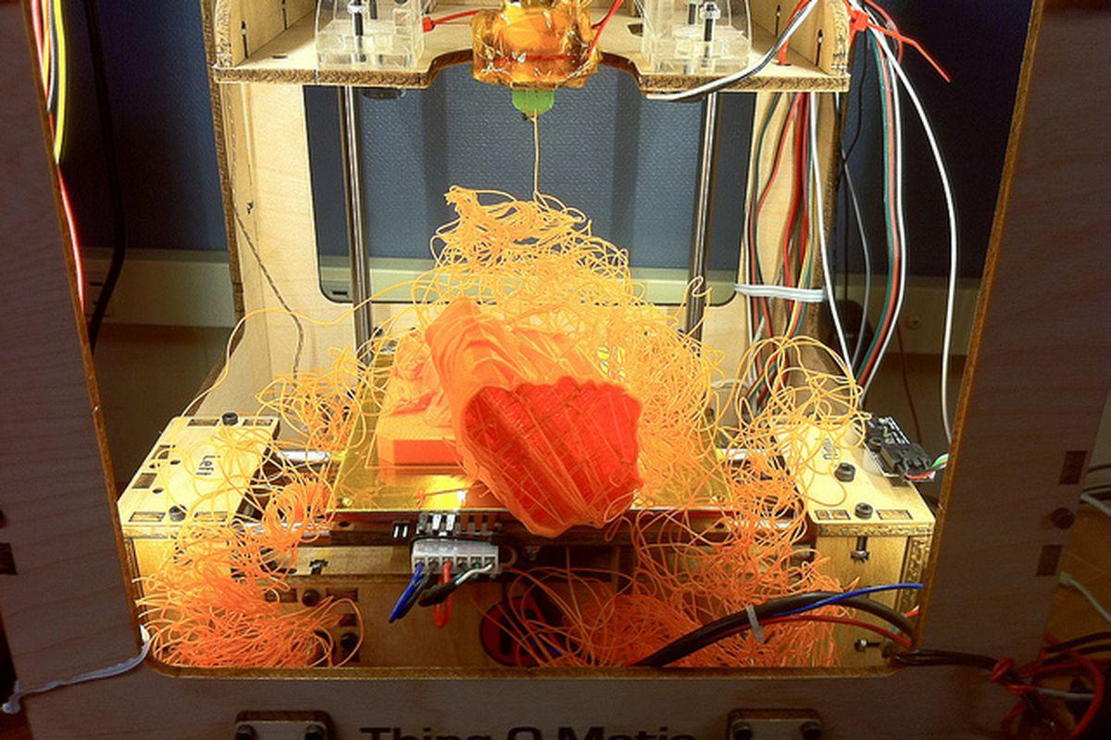
Problem Statement
Upgrading the Voxellab Aquila 3D printer
Leveling Mechanism
Bed adhesion
Improve the motion system
Improve the filament track
Bed Warping
Material Expansion
Source: the verge

Slide 5
03
Solution

Slide 6
Our Improvements
Automatic bed leveling
Bed adhesion
Part cooling
Heat sink cooling
Backlash
Uneven gantry loading
Vibrations
Extruder

Slide 7
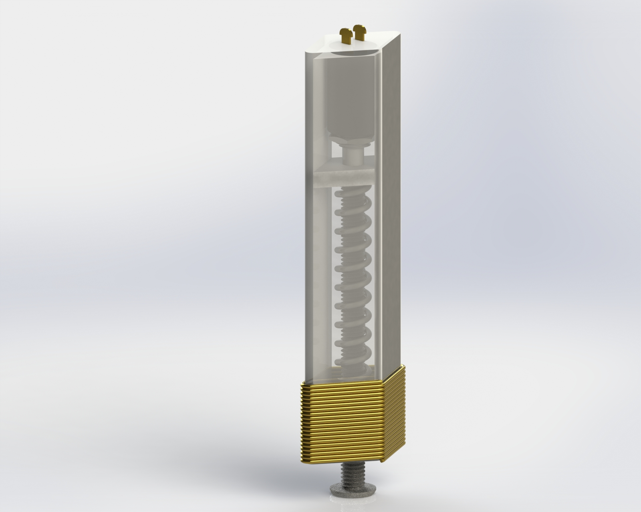
Bed Leveling, Warping, Adhesion
3 birds, 1 stone design
All materials will have warping
⬆ bed leveling = ⬆ bed adhesion
Low cost design
Elec-magnet actuation
Spring retraction
Notes:
This simple low-cost probe solves three problems
altogether.
Through research, we found most bed materials will have warping
thus, we use a probe to sample the bed.
The probe is attached to the nozzle. Durning probing, the elec-mag draws the steel core down. When the nail touches the bed, it triggers the push button. A signal is sent to Pronterface which makes the printer automatically compensate for the imperfections of the surfeace. This process tackles the bed leveling, warping, and adhesion problems.
After sampling, the nail retracts with the help of a spring so that it won't interfeace the nozzle.

Slide 8
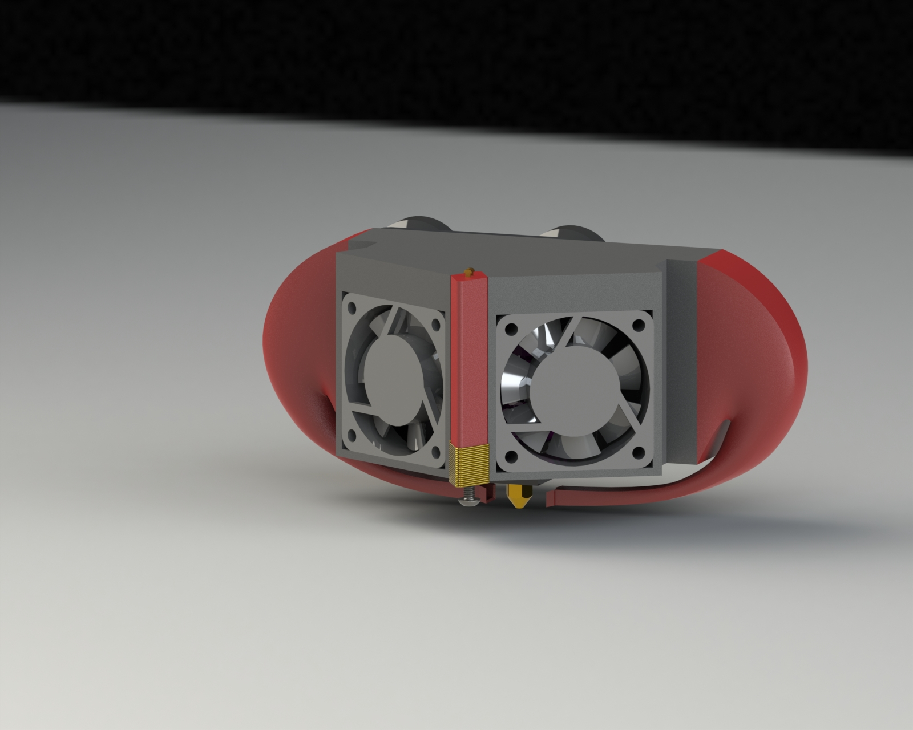
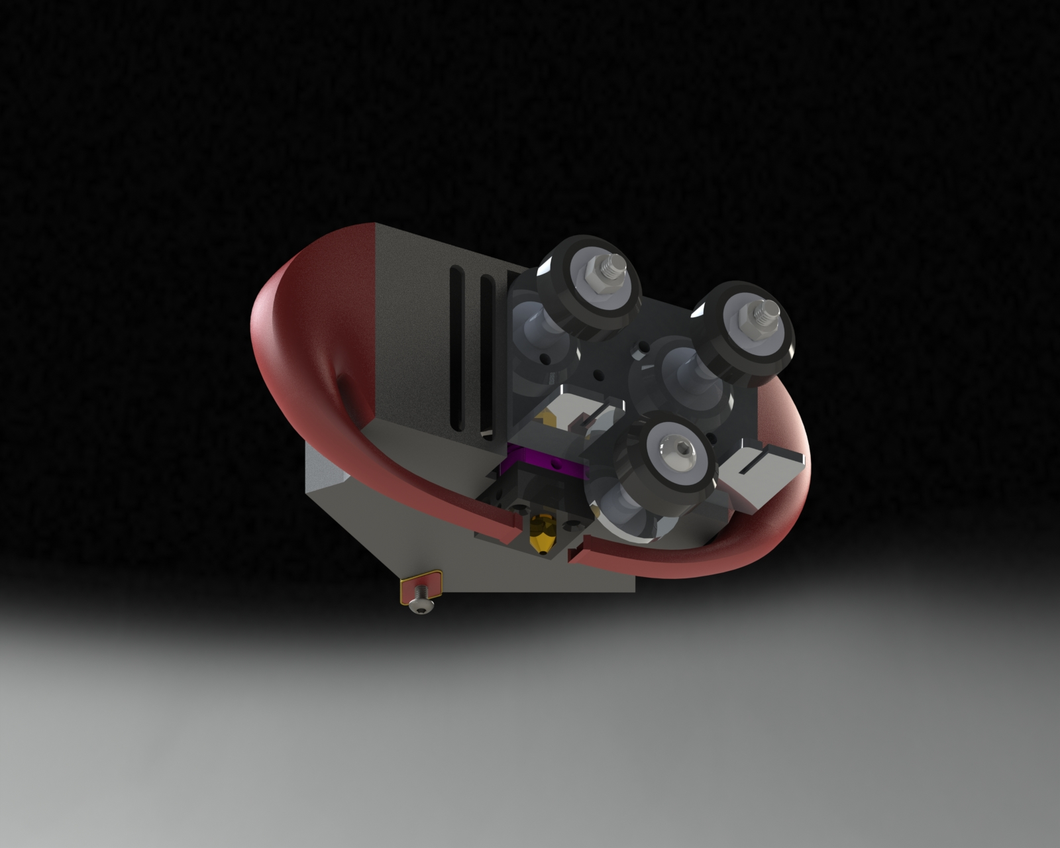
Cooling
Symmetrical part cooling
Further improves part adhesion
Prevents part warping
Improve bridging
Notes:
We improved the cooling with a two fans system.
Two wind turnels directs part of the air flow down, which cools the nozzle. This improves part adhesion, prevents part warping, and improves bridging.

Slide 9
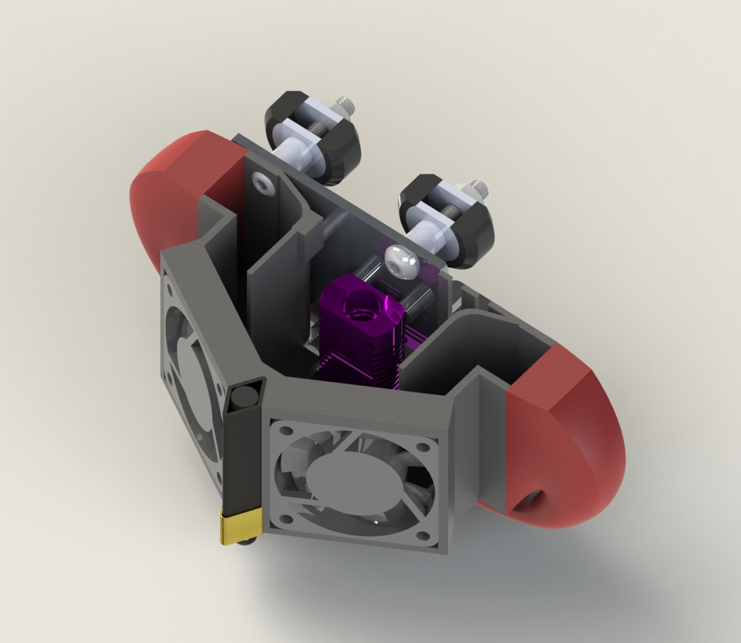
Cooling cont’
Improved heatsink cooling
⅔ + ⅔ air flow resulting is 1.33x better heatsink cooling
Reduces heat creep
Notes:
Thank you Yann
In addition to cooling the part, we also made sure to improve the heatsink cooling
This will allow us to print higher temperature materials like ABS without risking heat creep
Heat creep causes filament to prematurely melt above the heating element, which can cause clogging
Smooth barriers divide air flow - w/about ⅔ of the air from each fan travelling to the heatsink - giving us a 1.33x improvement over the current cooling

Slide 10
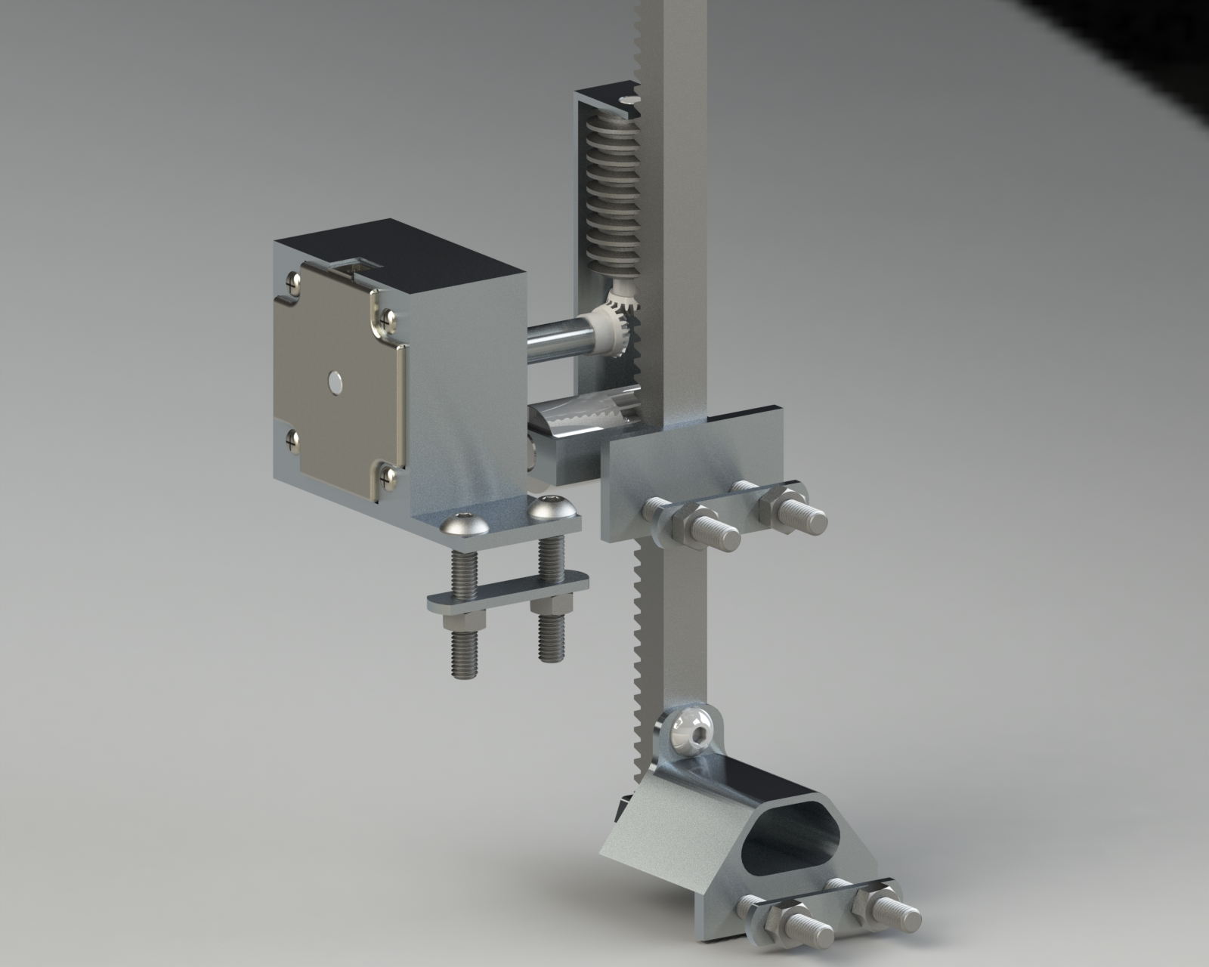
Backlash
Change orientation z-axis
Constant gravitational seating force
Mounted at the center of the
Worm gear
Prevents backdrive
Symmetric gantry loading
Eliminates eccentric z-axis
Notes:
We upgraded the z-axis drive, replacing the power screw with a new rack and worm design. Centered the lift, eliminating uneven gantry loading.

Slide 11
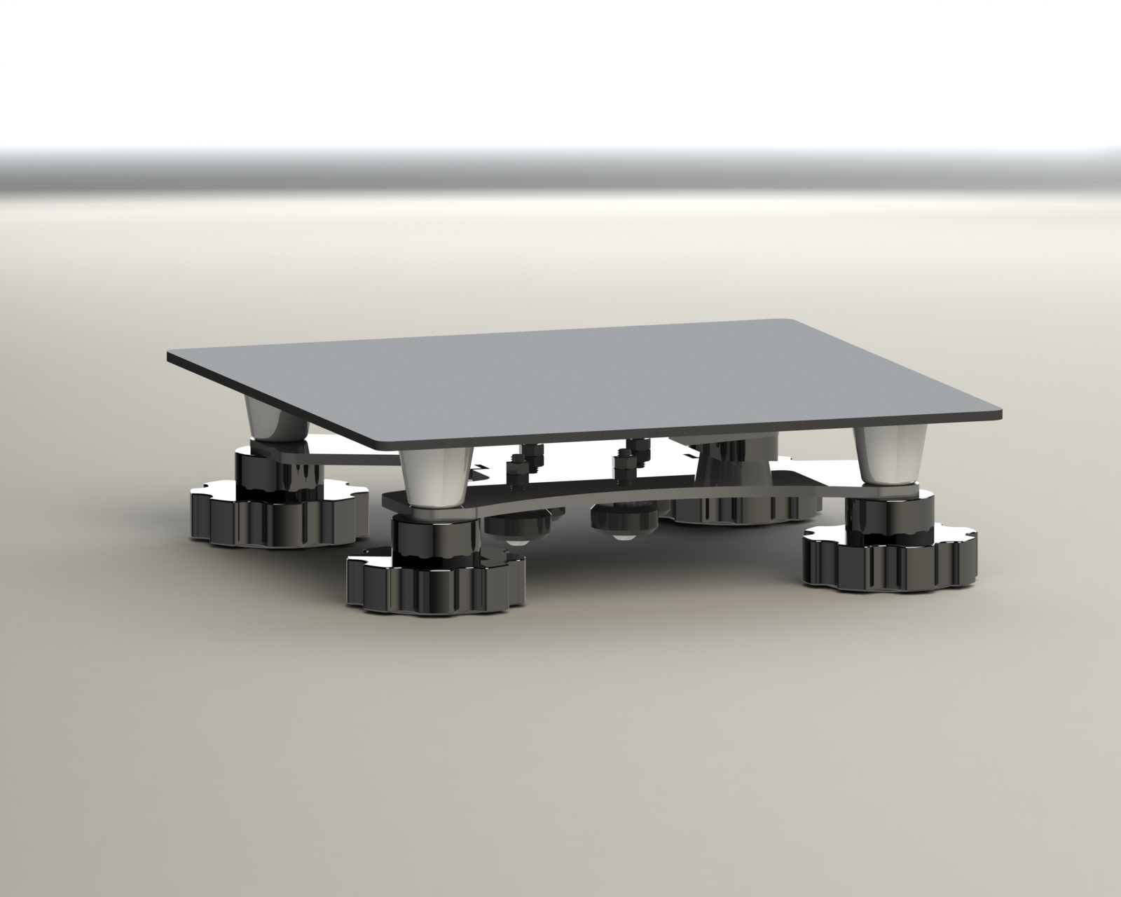
Vibration
Keep rubber belts for vibration dampening despite long term wear
Replaced springs with rubber dampers
Notes:
We were able to replace springs under bed thanks to our bed leveling solution - eliminate need for bed adjustment
Rubber belts provide a cost effective solution to drive the x and y axis movements while also acting as a damper for vibrations. We considered switching to chains, would increase service life, but it would not provide the same vibration damping effects. Using high precision gears would reduce backlash, but

Slide 12
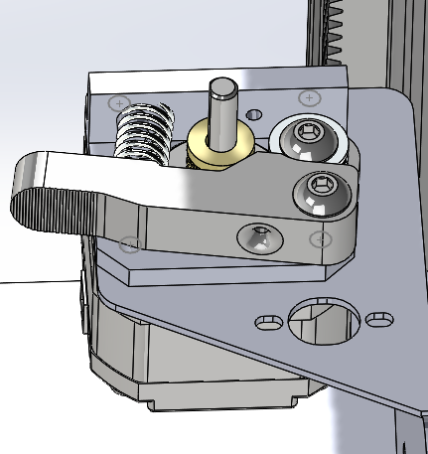
Extruder
Dual gear motor design
Improves accuracy and long term performance
Reduces:
Oozing
Stringing
Retraction issues
Notes:
Rubber belts provide a cost effective solution to drive the x and y axis movements while also acting as a damper for vibrations. We considered switching to chains, would increase service life, but it would not provide the same vibration damping effects. Using high precision gears would reduce backlash, but

Slide 13
04
Justification

Slide 14
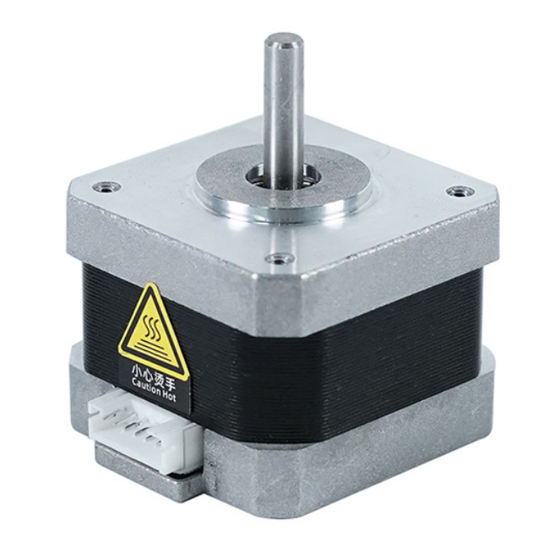
MATLAB
Determine torque for driving worm gear
Gear ratios
Considered factory safety of 1.5
(see appendix)

Slide 15
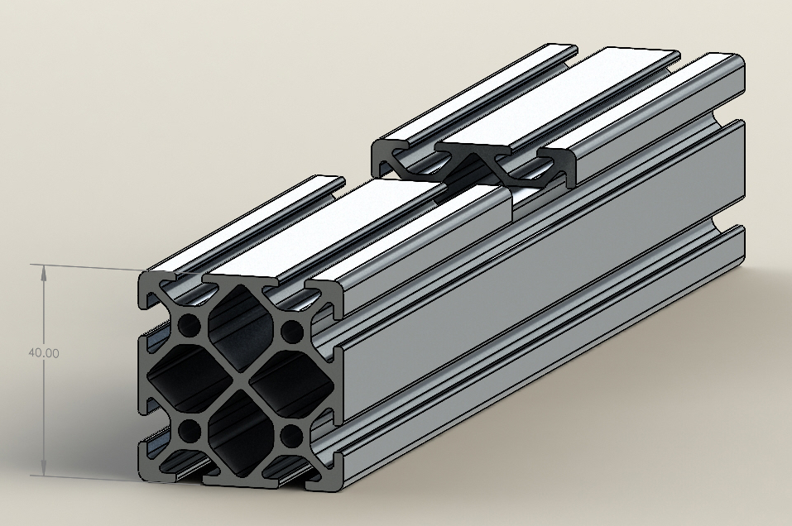
Manufacturing
New brackets are mostly aluminum sheets that have been stamped and bent
Plastic parts, such as cooling components are plastic and can be cast or molded depending on volume of production
We designed our new parts with manufacturing in mind
Notes:
We wanted to reduce cost as much as possible so we tried to use cheaper manufacturing methods. Designed our parts with manufacturing methods in mind. (like parts that can be bent or stamped)

Slide 16
05
Cost

Slide 17
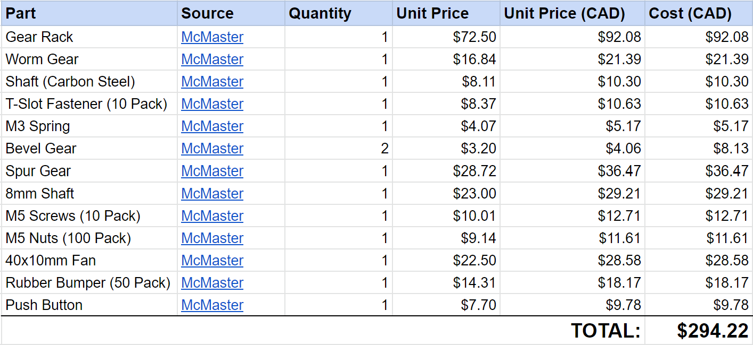
Upgrade cost breakdown
Notes:
We added a lot of expensive parts, but this also replaced a lot of the existing parts, such as the power screw. We were able to drastically improve the performance of the 3D printer. Accounting for the cost of the replaced parts we estimate that the net cost of our upgrades would be around $200.

Slide 18
06
Conclusion

Slide 19
Conclusion
High accuracy design
Entering mid-range market
Unique & innovative design
Modular and easily upgradable

Slide 20
Any Questions?
THANK YOU

Slide 21
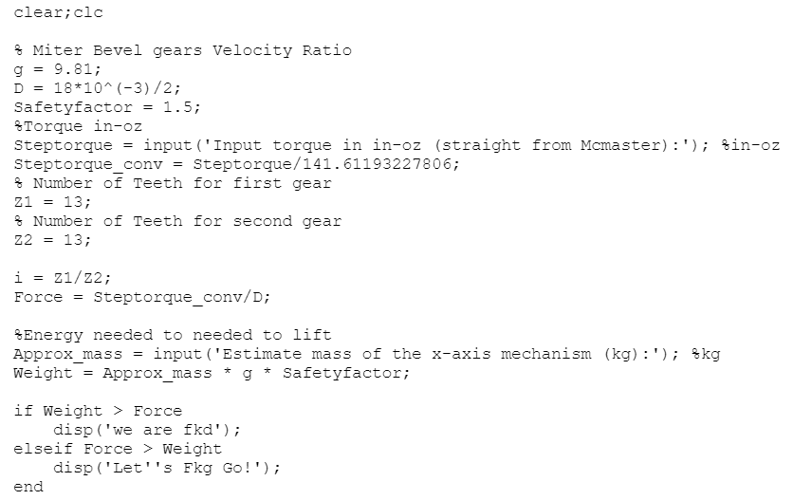
Appendix A: MATLAB

